Slide 1
Special libraries and COVID-19 - Lessons learned and future directions
Health Libraries Perspectives
3 December 2020
Rolf Schafer, Library Manager
St Vincent’s Hospital Sydney

Slide 2
Overview of Presentation
Highlights of the HLA Survey results – Australasian Health Libraries responses to the COVID-19 pandemic
HLA Initiatives in response to the COVID-19 pandemic
Redeployment: my journey from the Library to the Emergency Department
Insights into Library responses from the international literature

Slide 3
Hunt,T. (202Australasian Health Libraries Responses to the COVID-19 Pandemic: HLA Survey Results. JoHILA 1 (2): 33-43.

Slide 4
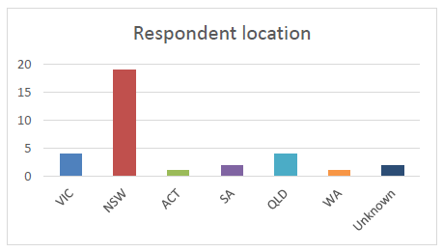
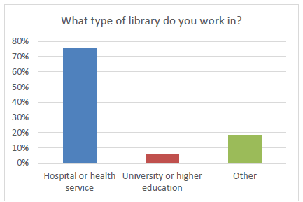
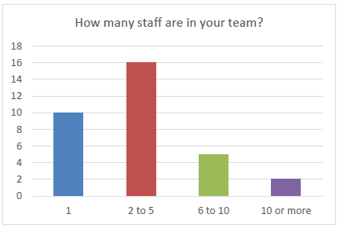
Demographics
33 respondents to the survey
Majority were from NSW
75% were from hospital or health service libraries
33% were solo librarians and 50% with 2-5 staff in their team

Slide 5
Redeployment
Four or 12% of respondents
Creating e-learning modules
Driving patients
Different departments for COVID specific work – Medical Records, Emergency
Contact tracing

Slide 6
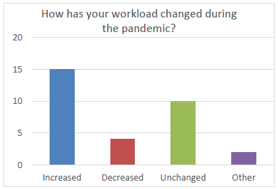
Workload levels during COVID
50% of respondents indicated an increase in workload
Increase in literature search requests
Increase in working from home
Increase in interlibrary loans/document delivery
Increase in support for technology

Slide 7
Operational Challenges
Working from home
Rescheduled training (or moving it online)
Establishing new processes for online meetings
Managing individual staff needs for altered tasks for working offsite
Temporary restructuring of jobs and teams to facilitate working from home, changes to work hours and responsibilities

Slide 8
Tools, techniques or strategies to support staff working online or offsite
Use of online tools such as MS Teams, Skype, Slack, Zoom, VPN access, laptops, monitors and keyboards for home, Pexip, Padlet, email and phone calls
Flexibility in work arrangements: alternating teams to provide onsite coverage
Social and/or physical distancing policies at work
Some libraries chose to close their doors to clients to manage infection control while others increased the use of disinfecting procedures at work while remaining open

Slide 9
Changes to Library services and modifications as a result of COVID-19
Print circulation and ILL
Training delivery
Collection development
Literature searching
Physical spaces
COVID specific alerting services
Budgets

Slide 10
HLA Initiatives in response to the COVID-19 pandemic
Issued a Statement of Support to Health Libraries and Health Library Workers
Curated content and resources regarding COVID-19
Hosted an online PD Event ‘Now, Next, Beyond COVID-19 – Health Librarians’ Experiences’ in July 2020
Surveyed health librarians’ experiences and published a COVID-19 feature edition of JoHILA
Funded a special research project: What Place has the Library Space? Lessons & reflections from COVID-19
Collaborated internationally to produce a suite of COVID-19 literature searches

Slide 12
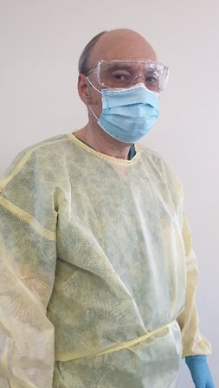
Redeployment: my journey from the Library to the Emergency Department
Expressions of Interest for non-clinical staff to be redeployed
Emergency Department redeployment to set up a PPE Safety Program and conduct compliance audits
PPE Literature Search
Completed in-service in donning and doffing PPE, use of the N95 mask

Slide 13
Redeployment: my journey from the Library to the Emergency Department
This is one of the key resources that I found that actually helped me in setting up the PPE audit
Reconfigured the space in ED: to have separate areas for donning and doffing increase in working from home
Ensure that there is one way in and one way out in terms of patient flow so to minimise the spread of the infection and contamination
Developed a checklist for the audit: checked over by the Clinical Nurse Educator and the Infection Control Clinical Nurse Consultant before we went with it

Slide 16
Insights into Library responses from the international literature
Repurposing resources
Using 3D printers in academic libraries to manufacture of PPE. Typical items included ear savers, clear plastic face shields, and face shield head bands.

Slide 17
Provision of information resources
Access to critical consumer health information resources about the virus
Library home pages incorporating quick links to general consumer health information resources, scientific organisations, federal and state health agencies
Developing LibGuides with more expansive lists of reliable information resources
Prepopulated searches to help researchers efficiently identify studies in subject areas of broad interest and need. For example, ALIA HLA produced a suite of COVID-19 literature searches for use in PubMed

Slide 18
Provision of information resources
Use of preprint servers such as MedRxiv, bioRxiv, ResearchSquare and Preprints.org. Google Scholar can also be useful for very recent publications on COVID-19
Many major publishers are providing free access to articles on COVID-19 or making their content freely available for a fixed period of time
Increased requests for literatures searches, systematic review or research synthesis services
Increased access to and use of library online resources by students, faculty, and researchers

Slide 19
Challenges posed by the pandemic
Impact on library spaces
Library closed with remote services operating
Library repurposed for use by clinical teams or for operational needs e.g. COVID Hotline call centre
Reduced opening hours as staff are working remotely and/or in rotating teams when on site
Provision of hand sanitiser and alcohol wipes to clean keyboards, mouses and print devices

Slide 20
Challenges posed by the pandemic
Impact on library spaces
Provision of social distancing measures to limit space capacity in rooms and at computer terminals/study desks
Provision of screens on reception/circulation desks
Reduced ability to obtain books and other materials on interlibrary loan as many libraries were closed or chose not to lend because of potential contamination from coronavirus

Slide 21
Remote Service Delivery
Working from home – challenges of accessing facility based IT systems; Internet connectivity
Supporting staff and students remotely
In-person sessions were quickly turned into an online format and delivered via Zoom or Microsoft Teams

Slide 22
Increased use of online tools and technologies
Email
Google Hangout
Messaging (SMS)
Microsoft Teams
Slack
WebEx
WeChat
Zoom

Slide 23
Support from Library Associations
Providing information and webinars to their members
Dedicated COVID-19 pages on the provision of library services during the pandemic
Reopening strategies
Sanitising of library materials and devices
Promotional material
Listing of related professional development activities

Slide 24
Closing Remarks
The global coronavirus pandemic has caused librarians to rethink how they delivery library services and support their respective clients
With many libraries closed, librarians were required to work remotely and embrace online tools to connect with colleagues and clients
For health librarians, managing the volume of COVID-19 information is a significant challenge

Slide 25
Closing Remarks
Librarians are resourceful in creating, LibGuides, prepopulated searches, links to specific COVID related resources
Be flexible and adaptable - be prepared for a whole new way of working
For those with the opportunity for redeployment - don’t be afraid to step outside of your comfort zone – you may surprise yourself how well you handle the new role and the various challenges that come along your way

Slide 26
Closing Remarks
“The information needs of health providers, consumers, and patients are continually evolving in response to the spread of the pandemic, so librarians must be able to identify the roles for which their essential skill-sets are needed and be ready to provide the vital resources that their communities need.”
Morgan-Daniel, J., et al. (2020). "COVID-19 Patient Education and Consumer Health Information Resources and Services." Journal of Consumer Health on the Internet 24(3): 302-313.

Slide 27
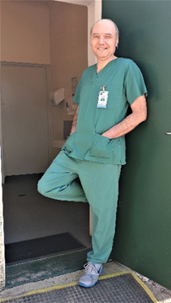
Thank you, any questions?
rolf.schafer@svha.org.au
+61 2 8382 2299
NSW St Vincent's Hospital Sydney

